Slide 1
C language - Part 3 Structure and Union
Arun Singh Presenter

Slide 2
Compilers: Quick reference
There are certain online compilers like
Jdoodle: https://www.jdoodle.com/c-online-compiler/
GeeksforGeeks: https://ide.geeksforgeeks.org/,
Ideone: http://ideone.com/ or
Codepad: http://codepad.org/ that can be used to start C without installing a compiler.

Slide 3
Structure Introduction
A structure is a collection of one or more variables, possibly of different types, grouped together under a single name for convenient handling.
Structures help to organize complicated data, particularly in large programs, because they permit a group of related variables to be treated as a unit.
Traditional example - an employee is described by a set of attributes such as name, address, social security number, salary, etc
More typical for C, comes from graphics: a point is a pair of coordinates, a rectangle is a pair of points, and so on

Slide 4
General format of Structure definition
Struct tag_name
{
data_type member1;
data_type member2;
… ...
}

Slide 5
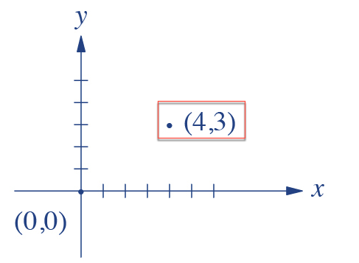
Syntax
Let's try to create a simple structure for a point
struct point {
int x;
int y;
};
struct point pt = {4,3};
struct point pt;
pt.x = 4;
pt.y = 3;

Slide 6
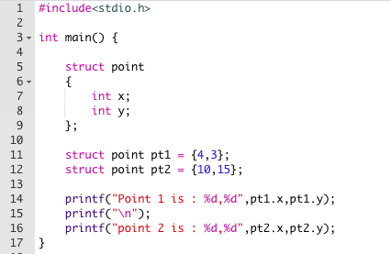
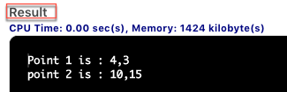
Program for creating 2 points and printing coordinates
https://www.jdoodle.com/iembed/v0/1O
Notes:
#include<stdio.h>
int main() {
struct point
{
int x;
int y;
};
struct point pt1 = {4,3};
struct point pt2 = {10,15};
printf("Point 1 is : %d,%d",pt1.x,pt1.y);
printf("\n");
printf("point 2 is : %d,%d",pt2.x,pt2.y);
}

Slide 7
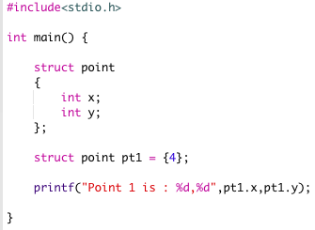

Member Initialization
If there are fewer initialization than that of member variables in the structure. The remaining member variables are initialized to zero/default value.
https://www.jdoodle.com/iembed/v0/1T

Slide 8
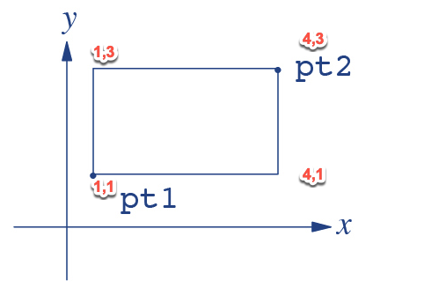
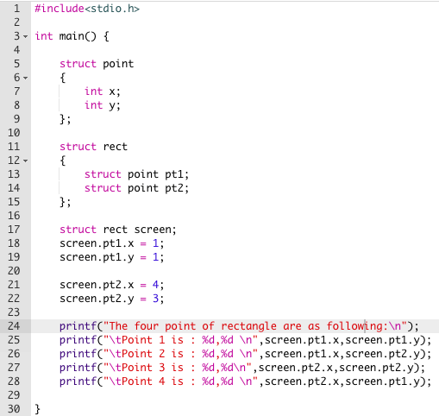
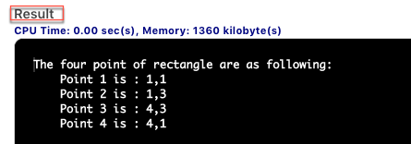
Program for representing a rectangle using previous point structure
https://www.jdoodle.com/iembed/v0/28

Slide 9
Exercise 1:
Write a program to store and print the roll no., name , age and marks of a student using structures.
HINT: https://www.jdoodle.com/iembed/v0/1Y

Slide 10
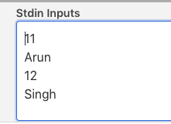
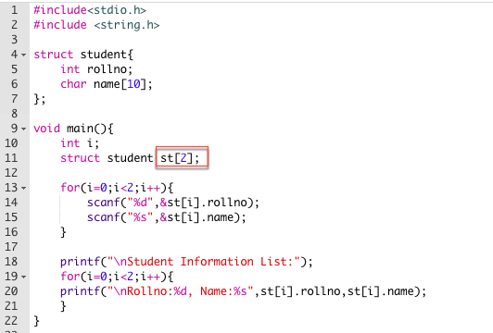
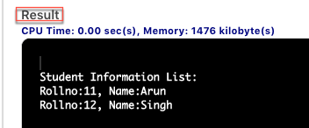
Array of Structure
Structure is collection of different data-types ( variables ) which are grouped together. Whereas, array of structures is nothing but collection of structures. This is also called as structure array in C https://www.jdoodle.com/iembed/v0/1W

Slide 11
Exercise 2:
Write a program to store the roll no. (starting from 1), name and age of 5 students and then print the details of the student with roll no. 2.
HINT : https://www.jdoodle.com/iembed/v0/1X
STD Input:
Shyam
15
Ramu
16
Malik
16
Rahim
15
Amit
16

Slide 12
UNIONS
Unions are a concept borrowed from structures and therefore follow the same syntax as structures.
A union is a special data type available in C that allows to store different data types in the same memory location.
You can define a union with many members, but only one member can contain a value at any given time.
Unions provide an efficient way of using the same memory location for multiple-purpose

Slide 13
Structure and Union (Syntax)
struct [structure name]
{
member definition;
member definition;
...
member definition;
};
union [union name]
{
member definition;
member definition;
...
member definition;
};

Slide 14
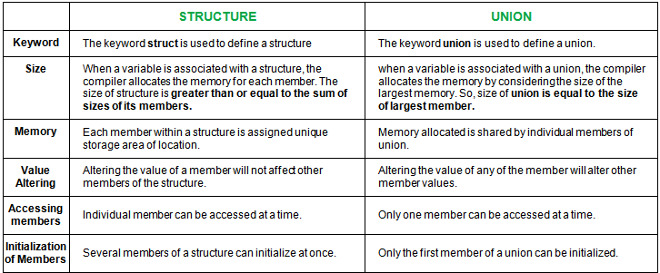
Comparison Structure and UNION

Slide 15
Data Types(Recap)
Basic Types:
integer types and
floating-point types.
Enumerated types:
They are again arithmetic types and they are used to define variables that can only assign certain discrete integer values throughout the program. (State of employee: Working/Left)
The type void
The type specifier void indicates that no value is available.
Derived types
Pointer types,
Array types,
Structure types,
Union types
Function types.

Slide 16
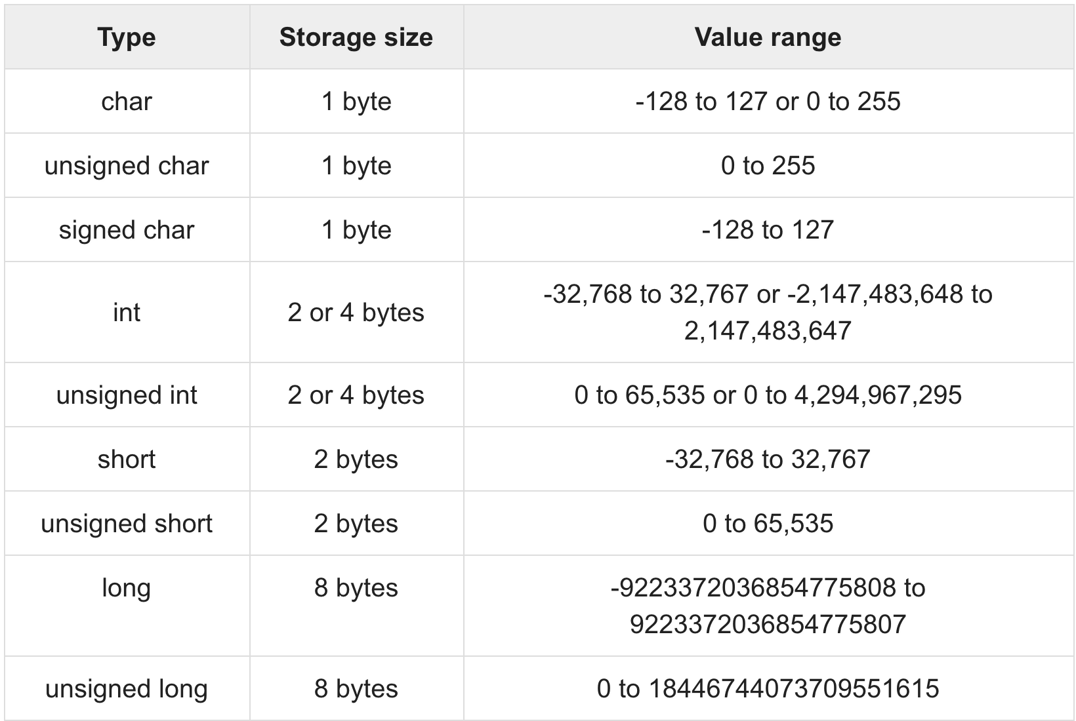
Integer types(Recap)
Notes:
Declare and assign

Slide 17
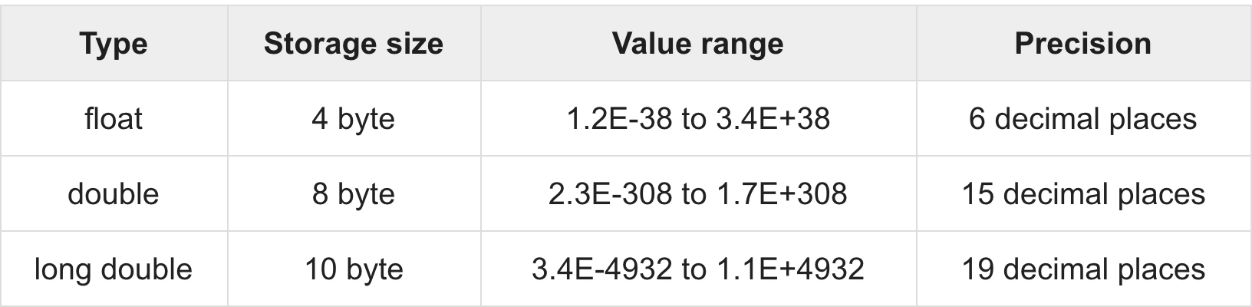
Floating-Point Types(Recap)

Slide 18
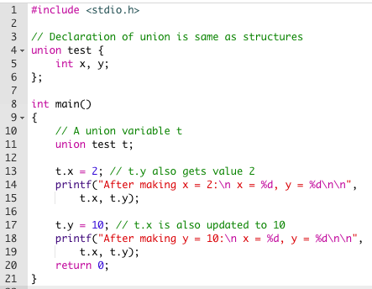
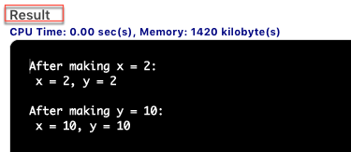
Union usage
https://www.jdoodle.com/iembed/v0/1Z

Slide 19
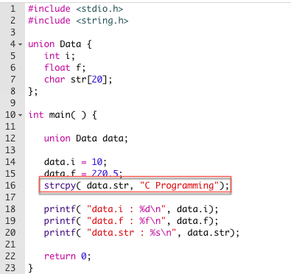
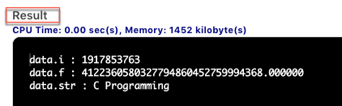
Accessing Union Members
https://www.jdoodle.com/iembed/v0/23

Slide 20
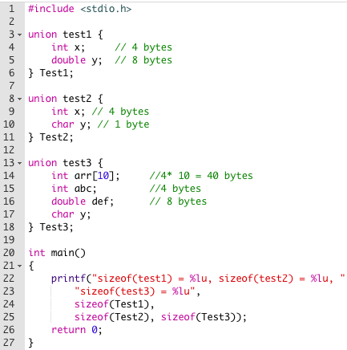
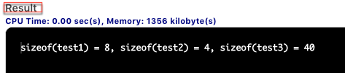
Size test with Union
https://www.jdoodle.com/iembed/v0/22

Slide 21
Usage of Union
Unions can be useful in many situations where we want to use the same memory for two or more members
Unions are particularly useful in Embedded programming or in situations where direct access to the hardware/memory is needed
Since Unions allow data members which are mutually exclusive to share the same memory. This is quite important when memory is more scarce

Slide 22
Exercise 3:
Write a program to using union and structure and see the difference the size. HINT: https://www.jdoodle.com/iembed/v0/26

Slide 23
Excercise 4
Write a program to add, subtract and multiply two complex numbers using structures to function
HINT: https://www.jdoodle.com/iembed/v0/2a

Slide 24
Exercise 5
Write a program to compare two dates entered by user. Make a structure named Date to store the elements day, month and year to store the dates. If the dates are equal, display "Dates are equal" otherwise display "Dates are not equal".
HINT : https://www.jdoodle.com/iembed/v0/2b

Slide 25
Exercise 6
Write a program to store and print the roll no., name, age, address and marks of 15 students using structure.

Slide 26
Thank you

